Slide 1


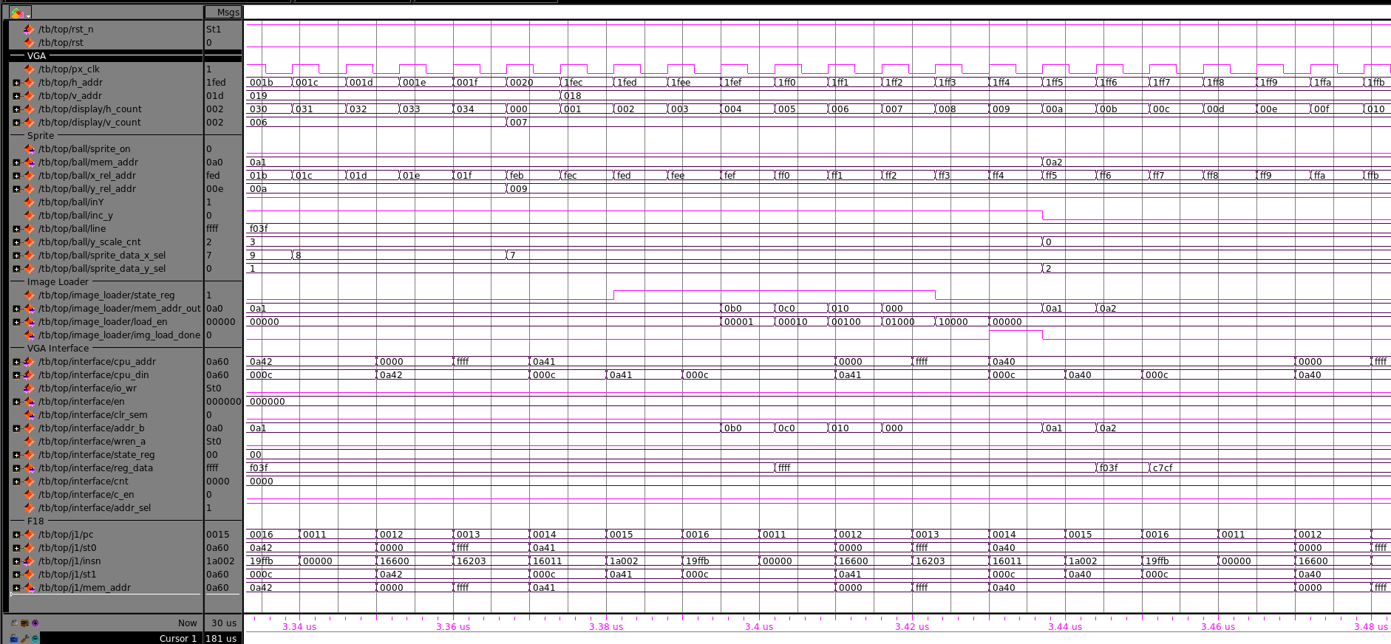
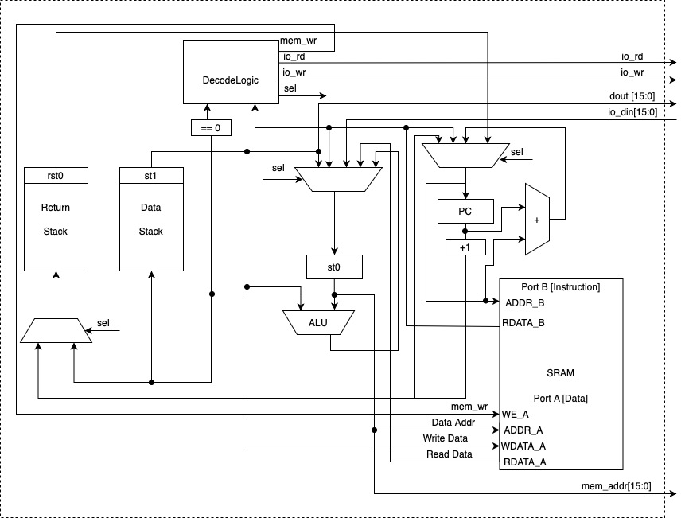
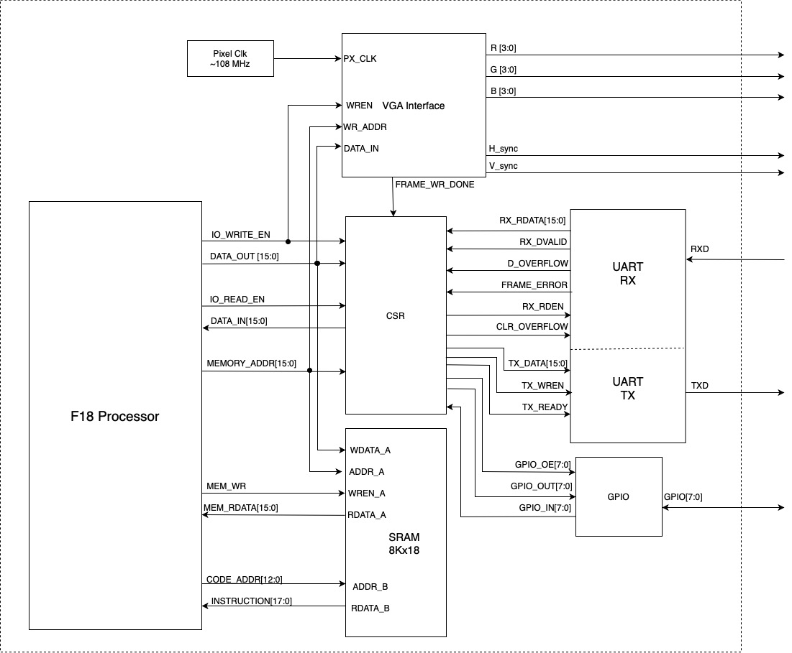
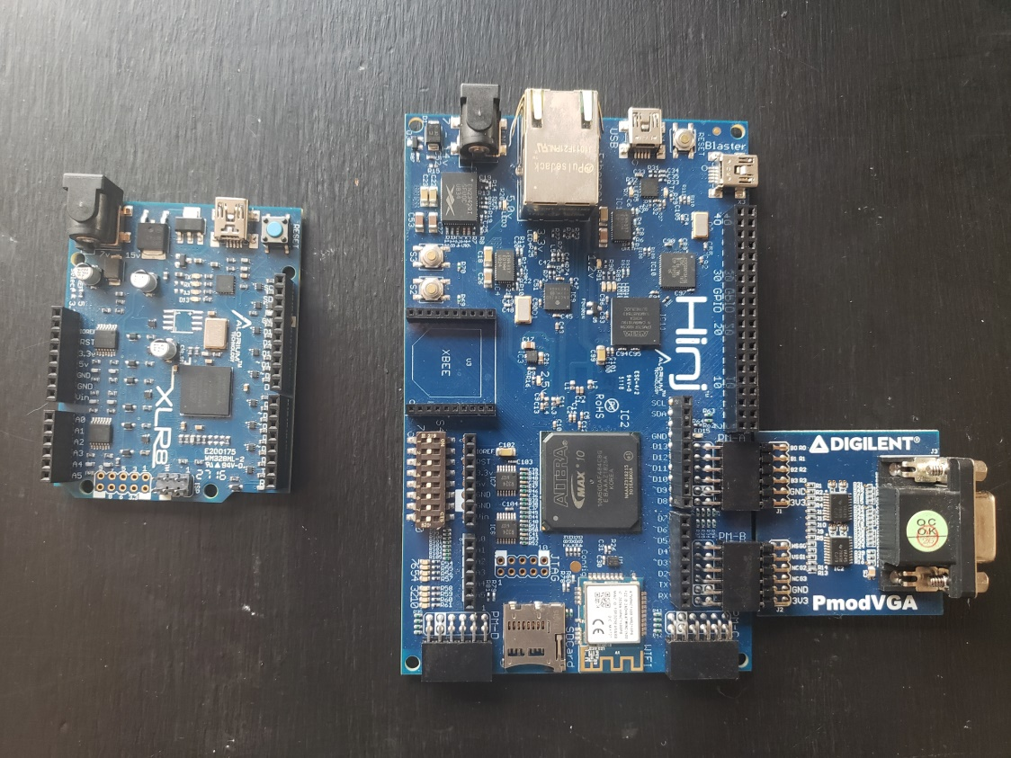
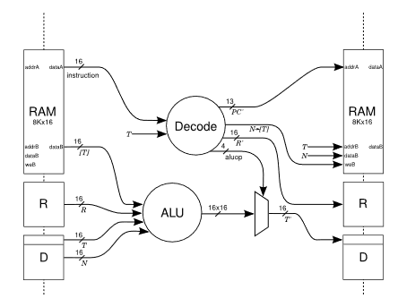

FORTH Computing on FPGA
Team Members: Jess Totorica, Kyle Hartman, Thys Ballard, Kyle Hild, Ronald Crump
Objective
Final Design
Testing and Validation
Develop an Arduino-like board/platform based upon an FPGA executing FORTH bytecode instructions.
F18 Processor
Designed specifically for running FORTH
Two RAM based LIFO stacks
Data Stack: Data manipulation and calculation
Return Stack: Stores return address for function calls
18-bit instruction width, 16-bit data paths
Uses true dual port SRAM for data and program storage
16 MHz clock
Background
FORTH is a very small programming language that was originally developed for controlling scientific instrumentation.
A custom designed soft-CPU that executes FORTH instructions on an FPGA is a very versatile, low power, and small form factor way to accomplish many computing tasks.
Our design, called the F18, is ideal for applications with many arithmetic calculations, high data throughput, or as a controller for designs with other subsystems.
Logic analyzer waveforms were used very regularly to observe the functionality of different design elements. This shows sprite data being loaded from RAM to an internal register to be later drawn to the screen.
Develop an Arduino-like board/platform based upon an FPGA executing FORTH bytecode instructions.
-Full ANS FORTH on board
-Arduino like tools/Functions
-Interrupts
-Prototype PCB
UART (Universal Asynchronous Trans./Rec.
Allows for serial communication with external devices
VGA (Video Graphics Array)
Allows for display on VGA monitor
Specifically designed for displaying Pong game
GPIO (General Purpose I/O)
Allows for input and output to/from physical pins on board
CSR (Control/Status Registers)
Coordinates data flow between I/O peripherals and F18 processor
System Input/Output
Going Forward
Throughout the year this project changed and grew. Our final design met the specifications of a CPU on an FPGA that executes FORTH instructions, and was geared toward running the pong program on the custom F18 processor. Moving forward these are some things we would like to implement and add:
Full ANS FORTH on the board
Arduino like tools/functions
Hardware interrupts
Prototype custom PCB
Concept Development
Several development boards were used for this project, with the Alorium Hinj being the final choice due to the convenient features and easy expansion.
The J1, an FPGA based Forth CPU created by James Bowman, served as inspiration for the project.
Acknowledgements
Thanks to Peter Baran for being a sponsor, mentor and teacher. Thanks to Mark Sapper for his help with hardware design and debugging. Thanks to James Bowman for allowing us to use his J1 core design. Thanks to Bruce Bolden for being the lead instructor throughout this project.

